Slide 2
C++ Coroutines by example
Motivation
Introduction to coroutines
Example #1: Turn Generator into coroutine.
Example #2: Turn Printer into coroutine
Additional examples
Epilog

Slide 3

Motivation

Slide 4
Introduction to coroutines

Slide 5
C++20: “the big four”
Concepts
Modules
Ranges
Coroutines

Slide 6
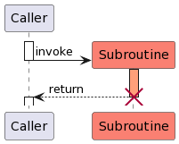
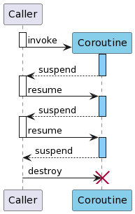
What is different about a coroutine?
Subroutine
Coroutine

Slide 7
What is different about a coroutine?
A subroutine is invoked, performs its work and returns. When returning, the subroutine invocation is terminated and is cleaned-up (variables on stack are deleted, ...).
A coroutine is invoked and performs some work. When it reaches a suspension point it transfers control back to the caller without cleaning-up.
The caller can then decide to resume the coroutine again.
The coroutine might no longer terminate itself: The caller has to destroy the coroutine.

Slide 8
What makes a routine a coroutine?
The use of at least one of the following keywords:
co_yield
co_await
co_return
Coroutines are not recognizable as such in the method signature.
Keyword | Meaning
co_yield | Pass a value from the coroutine and transfer control to caller.
co_await | Wait until a certain condition is given. Might also be used to transfer values to the coroutine.
co_return | End a coroutine and possibly return a value.

Slide 9
Example #1: Turn Generator into coroutine.

Slide 10

Example #1: Live coding...

Slide 11
Relation of Return object and Promise object
Coroutine context (heap)
Return object (stack)
coroutine_handle
promise()
done()
resume()
destroy()
<<has>>
Promise object
<<creates>>
<<returns>>
co_yield
co_await
co_return
<<has>>
<<creates>>
Caller
Coroutine
<<invokes>>

Slide 12
Anatomy of a coroutine
ReturnObject myCoroutine(int param) {
while (condition) {
co_yield doWork();
if (anotherCondition) {
co_return value;
}
}
co_return;
}

Slide 13
Anatomy of a coroutine (attn: pseudo-code!)
ReturnObject myCoroutine(int param) { | ReturnObject myCoroutine(int param) {
 | auto promise = new ReturnObject::promise_type{};
 | // or auto promise = new ReturnObject::promise_type{param};
 | auto return_object = promise->get_return_object();
 | co_await promise->initial_suspend();
 | try {
while (condition) { | while (condition) {
co_yield doWork(); | co_await promise->yield_value(doWork());
if (anotherCondition) { | if (anotherCondition) {
co_return value; | promise->return_value(value);
 | goto end;
} | }
} | }
co_return; | promise->return_void();
 | goto end;
 | } catch (...) {
 | promise->unhandled_exception();
 | }
 | end:
 | co_await promise->final_suspend();
 | delete promise;
} | }

Slide 14
Anatomy of a coroutine
The return type of a coroutine is normally not void.
return_object is returned to the caller with the first taken suspension. Caller is continued right after the invocation of the coroutine.
With each following suspension, nothing is returned since the caller is continued after the call to coroutine_handle::resume().
promise_type::final_suspend() is always called as the last thing in the coroutine. Even if the coroutine was ended by a call to co_return or because an exception was caught.
Each suspension point is introduced by co_await. The operation afterwards has to result in a awaiter object which controls, if the coroutine is suspended or not.
coroutine_handle::done() only returns true, if the coroutine is currently suspended in the final suspension point. If the final suspension point is not taken there is no reliable way of detecting from the outside, that the coroutine has ended.
Always cleanup from the outside with coroutine_handle::destroy().

Slide 15
Example #2: Turn Printer into coroutine

Slide 16

Example #2: Live coding...

Slide 17
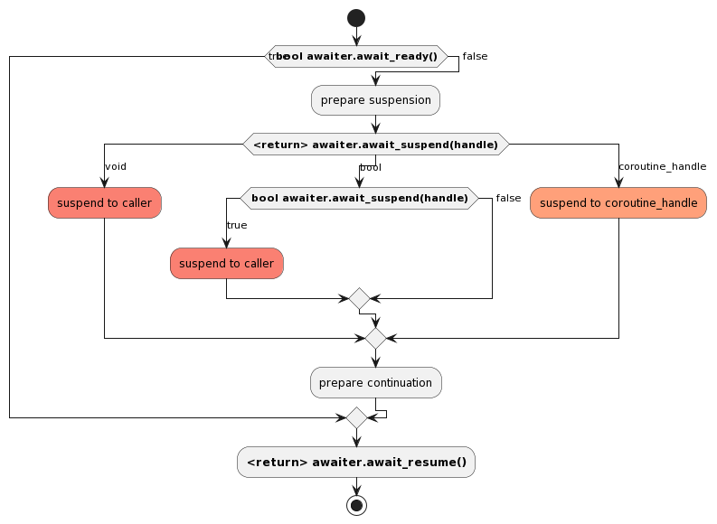
Anatomy of an awaiter

Slide 18
Epilog

Slide 19
Additional examples

Slide 20
Review
Very flexible, but rather complex solution.
Allows lots of things. But must be properly encapsulated (first thing is std::generator<> in C++23)
Danger of “lingering” coroutines (not destroyed).
Suitable for things like
Sources (like Generator)
Sinks (like Printer)
Co-operative multi-tasking in deeply embedded projects (without proper OS support)
Waiting for async system calls
...

Slide 21
Review
Alternatives
Rewritten algorithms
Threads

Slide 22
Links
Presentation, examples (Go to coroutines in repository): https://github.com/bbvch/embedded-community
cppreference.com
https://en.cppreference.com/w/cpp/language/coroutines
https://en.cppreference.com/w/cpp/coroutine
YouTube
https://youtu.be/8sEe-4tig_A
https://youtu.be/lm10Cj-HNKQ

Slide 23
Beat Schär | Senior Embedded Engineer
bbv Software Services AG
Schwanengasse 1
3011 Bern
beat.schaer@bbv.ch
Phone +41 31 378 08 10
Mobile +41 79 667 19 72
www.bbv.ch

